Slide 1
Hospitality Analysis
By Group 6
Rachana Suthar
Ninad Nilesh Nikam
Lovely Jay
Vishwajit Balaji Tawade

Slide 2

Agenda
6. GRATITUDE
1. COMPANY OVERVIEW
5. CHARTS & INSIGHTS
PROJECT
2. DATA MODEL
4. DASHBOARD
3. KPI’s

Slide 3




Company Overview
COMPANY
HOTELS
CITY
CATEGORY/ CLASS
BOOKING PLATFORMS
AtliQ Grands owns multiple five-star hotels across India. They have been in the hospitality industry for the past 20 years. Founded in 2017, AtliQ emerged as an IT & Business Consulting company.
Atliq Bay Atliq Blu Atliq City Atliq Exotica Atliq Grands Atliq Palace Atliq Seasons
Hyderabad Bangalore Delhi Mumbai
Business Luxury Standard Elite Premium Presidential
Direct Offline Direct Online Journey LogTrip MakeyourTrip Tripster Others

Slide 4
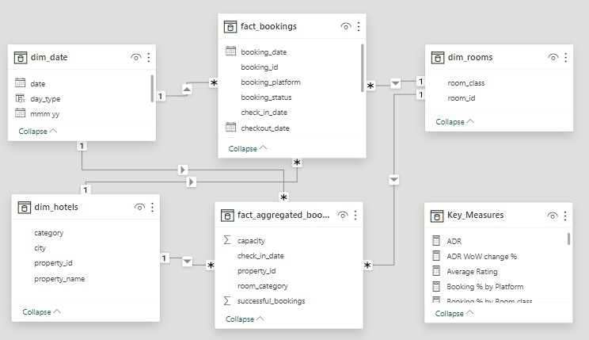
Data Model

Slide 5

Key Performance Indicators
Hospitality Domain
RevPAR (Revenue Per Available Room) = Total Revenue / Total Rooms Available to Sell
ADR (Average Daily Rate) = Total Rooms Revenue/ No. of Rooms Sold
Occupancy %=
Total Rooms Occupied/ Total Rooms Available
RevPAR
ADR
Occupancy
DSRN
DURN
DBRN
Realization
DSRN - Daily Sellable Room Nights
Realization = DURN/DBRN
DURN- Daily Utilized Room Nights
DBRN (Daily Booked Room Nights) = DURN + No Show + Cancellation

Slide 6
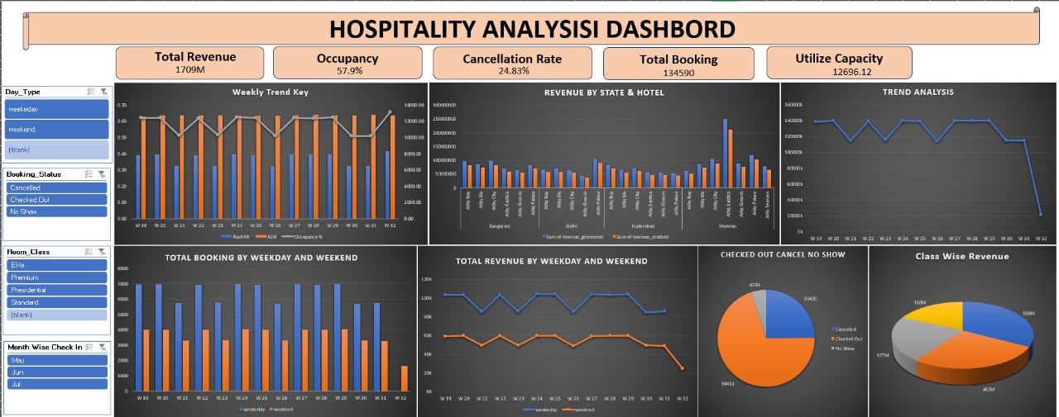
EXCEL dashboard

Slide 7
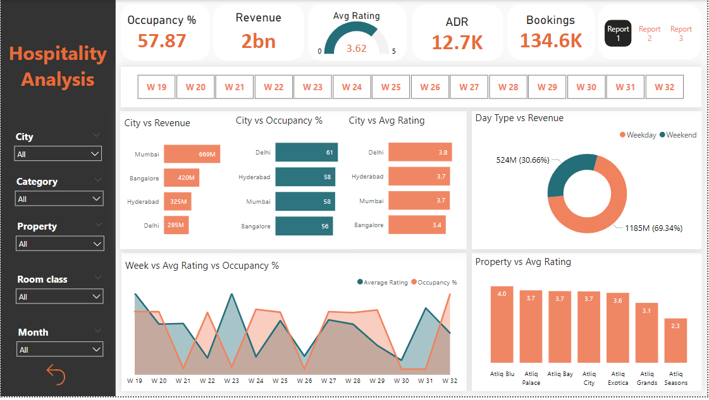
Power Bi
Dashboard

Slide 8
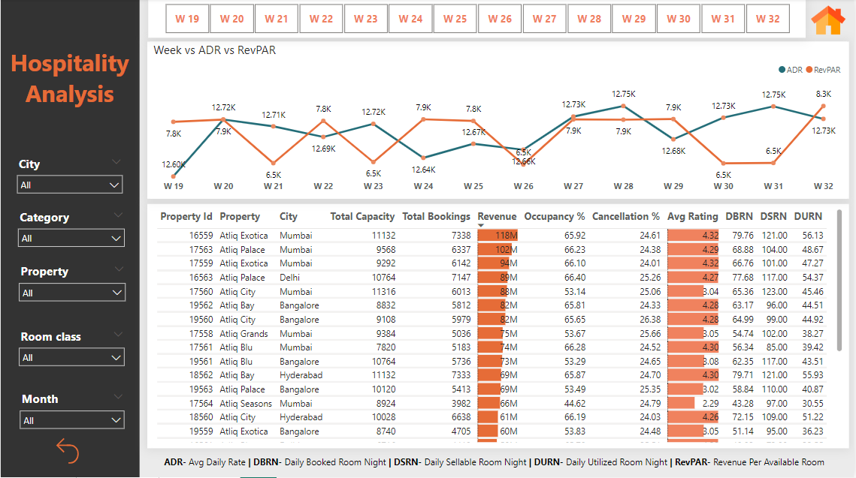
Power Bi
Dashboard

Slide 9
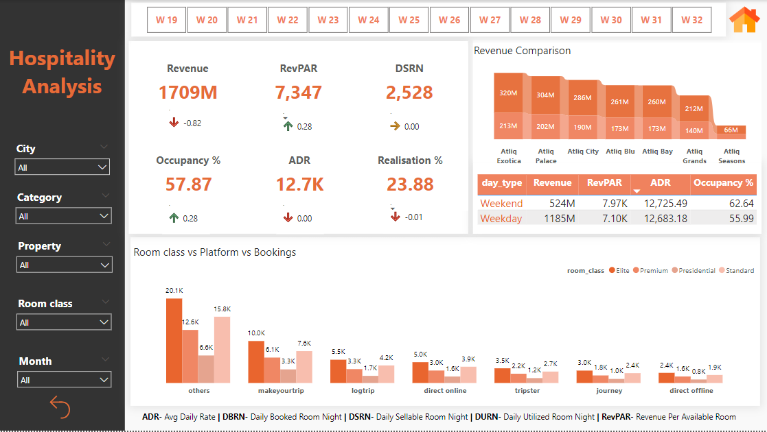
Power Bi
Dashboard

Slide 10
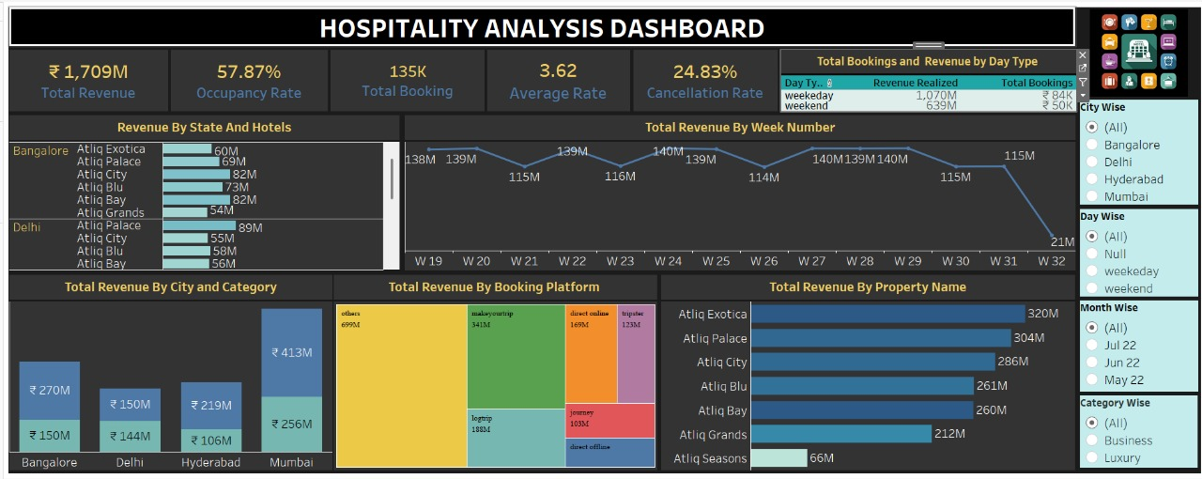
Tableau
Dashboard

Slide 11
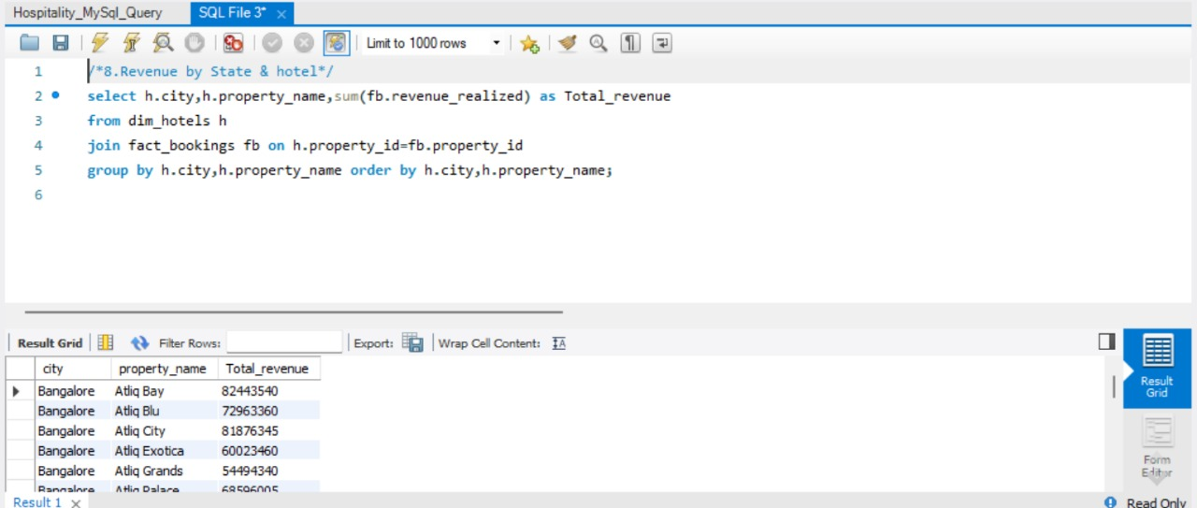
SQL Query
Dashboard

Slide 12
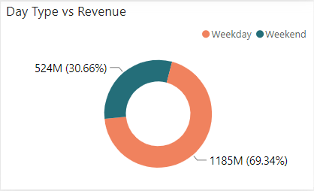

Insights
During weekdays, the revenue totals 1185 million rupees, representing 69.34% of the total revenue.
Occupancy stands at 55.99%, with an Average Daily Rate (ADR) of 12,683.18 rupees and Revenue per Available Room (RevPAR) of 7.10 thousand rupees.
Atliq Exotica Hotel leads in revenue with 222 million rupees, while Mumbai alone contributes 147M rupees. On the other hand, Atliq Seasons records a comparatively lower revenue of 46M rupees during weekdays.
During weekends see a revenue of 524 million rupees, constituting 30.66% of the total revenue.
Occupancy increases to 62.64%, accompanied by a slightly higher ADR of 12,725.49 rupees and an improved RevPAR of 7.97 thousand rupees.
Atliq Exotica maintains its high revenue status with 98M, while Atliq Seasons generates 20M, surpassing other hotels during weekends

Slide 13
Thank You

